Slide 1
Boys Lacrosse Season
2019

Slide 2
Agenda
Transformational Coaching Statement
FinalForms
FENWICKSPORTS.ORG
Player Expectations
Parent Expectations
Playing Time/Letter Criteria
Volunteer Signup
Thank you and questions

Slide 3
Transformational Coaching Statement
Your lacrosse coaching staff commits to creating a family atmosphere within our program. We will accomplish this by teaching the value of empathy, helping each other through hard times, celebrating our successes, and learning from our failures. We will value service to others, giving each other our best effort, and having fun playing this great sport.
Phil Keegan
Patrick Poplis
Nick Von Dohre

Slide 4
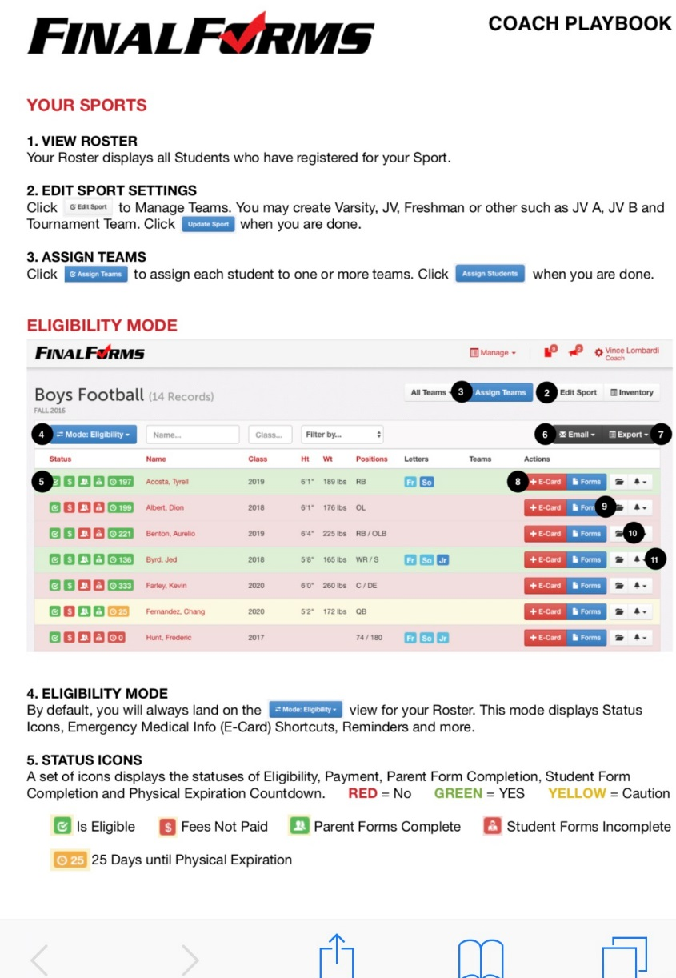
FinalForms

Slide 5
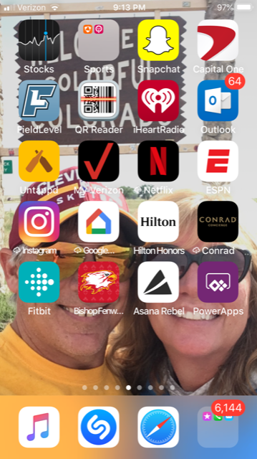
FENWICKSPORTS.ORG
Look in the App Store for Fenwicksports.org and download onto your mobile device or computer

Slide 6
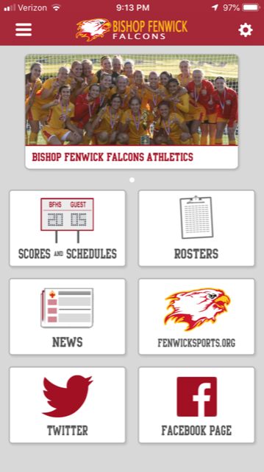
FENWICKSPORTS.ORG
Open the app and you’ll come to the main page for the school. Click on the picture.

Slide 7
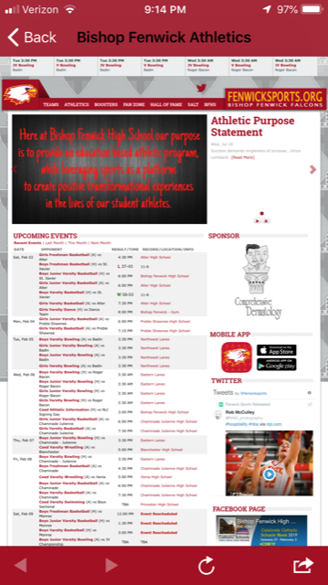
FENWICKSPORTS.ORG
You’ll now see this page that shows all the current events and gives you several options in the red tool bar. Click on TEAMS.

Slide 8
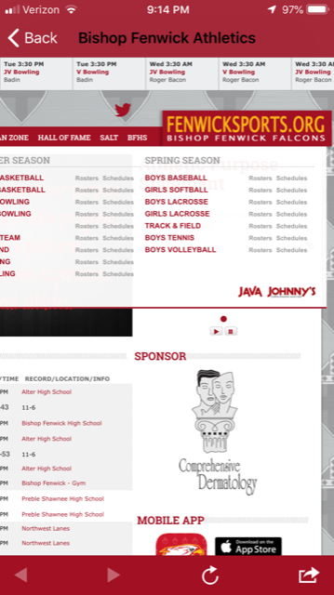
FENWICKSPORTS.ORG
You’ll now have the option to choose any team at Fenwick. This view is cropped so you can see mainly the spring sports. Click on BOYS LACROSSE.

Slide 9
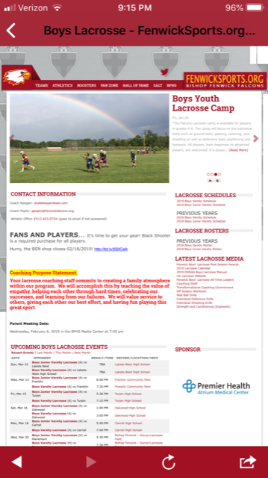
FENWICKSPORTS.ORG
Now you have arrived at our page, where most of the communication will be done throughout the season. In the right hand column there is a variety of valuable information for your use.

Slide 10
Player Expectations
Give 100% effort in the classroom, both with studies and behavior
Be present and on time for all practices and games
Excused absences include illness, injury, and family emergency. In general, earning service hours IS NOT an excused absence.
Any absence/tardiness must be communicated to one of the coaches PRIOR to the practice/game in question.
Give 100% effort during practices and games
Be respectful of teammates, officials, parents and coaches at all times
Be an ambassador for our team in school, on the field, and in public at all times

Slide 11
Parent Expectations
Support your son(s) in a positive manner – this IS NOT an easy sport
Volunteer in the various support roles to the best of your ability
Be respectful of teammates, officials, other parents and coaches at all times
Be an ambassador for our team in the stands and in public at all times
If you have a question or concern, please call or email any one of the three coaches on staff

Slide 12
Playing Time/Letter Criteria
To START a varsity game, a player needs to complete the mile in the following time:
Attack/Midfield/Defense: 6:15
Goalie: 7:00
NO EXCEPTIONS EXCEPT SENIOR NIGHT
Players will be continuously evaluated on:
Playing ability
Field conduct
Attitude
Varsity letters are awarded based upon:
Regular contribution in varsity games
The primary backup goalie gets a letter, regardless of varsity playing time

Slide 13
Volunteers

Slide 14
Thank You!

